Slide 1
The Low-Income Housing Tax Credit
And Affordable Housing Production
Rebecca Wagner – PPOL 5202

Slide 2
Table of Contents
01 | The American Affordable Housing Crisis
02 | An Overview of the Low-Income Housing Tax Credit (LIHTC)
03 | The LIHTCH Database and Missing Data
04 | A Brief History of LIHTC
05 | A National and State Overview of LITCH
06 | Low Income Units and Mixed-Income Housing
07 | Difficult Development Areas & Qualified Census Tracts
08 | Takeaways and Next Steps

Slide 3
The Problem
The United States has a Housing Problem:
Inflation, high interest rates, and stagnating incomes
Lack of new (affordable) housing development
Diminishing supply drives up housing prices, while families can afford less.
This problem does not impact all Americans equally:
Only 35 affordable homes exist for every 100 extremely-low income renters.
— National Low Income Housing Coalition, 2025

Slide 4
The Problem
The United States has a Housing Problem:
Inflation, high interest rates, and stagnating incomes
Lack of new (affordable) housing development
Diminishing supply drives up housing prices, while families can afford less.
The United States has a Housing Problem:
Inflation, high interest rates, and stagnating incomes
Lack of new (affordable) housing development
Diminishing supply drives up housing prices, while families can afford less.
Why focus on development?
Addressing fundamental shortages
Political and public sentiment re: deregulation
Creating jobs, working within the private market

Slide 5
The Low-Income Housing Tax Credit (LIHTC)
What is LIHTC?
Provides dollar-for-dollar tax credits to developers who build or rehabilitate affordable housing units
Administered by state housing finance agencies, which allocate credits
Requires units to remain affordable for at least 30 years, renting to tenants with specific income thresholds (i.e., 50% of AMI)
Largest source of affordable housing production in the U.S.

Slide 6
The Data
The Department of Housing and Urban Development Office of Policy Development & Research publishes a property-level database on LIHTC Projects.
54,102 projects
3.7 million housing units
Spanning 1987-2023
Each state is required to report certain data on their LIHTC developments.
This reporting is heterogenous and often flawed.

Slide 7
The Data

Slide 8
History of LIHTC

Slide 9
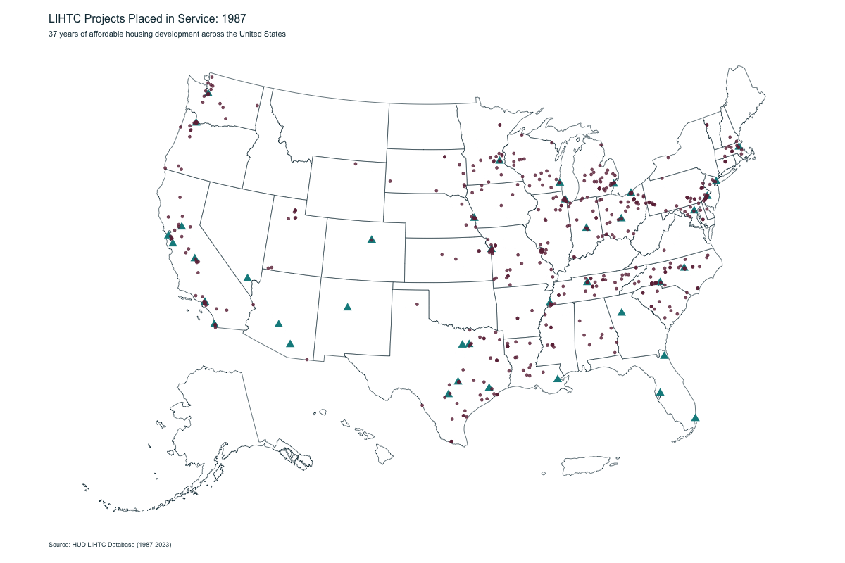
National Overview

Slide 10
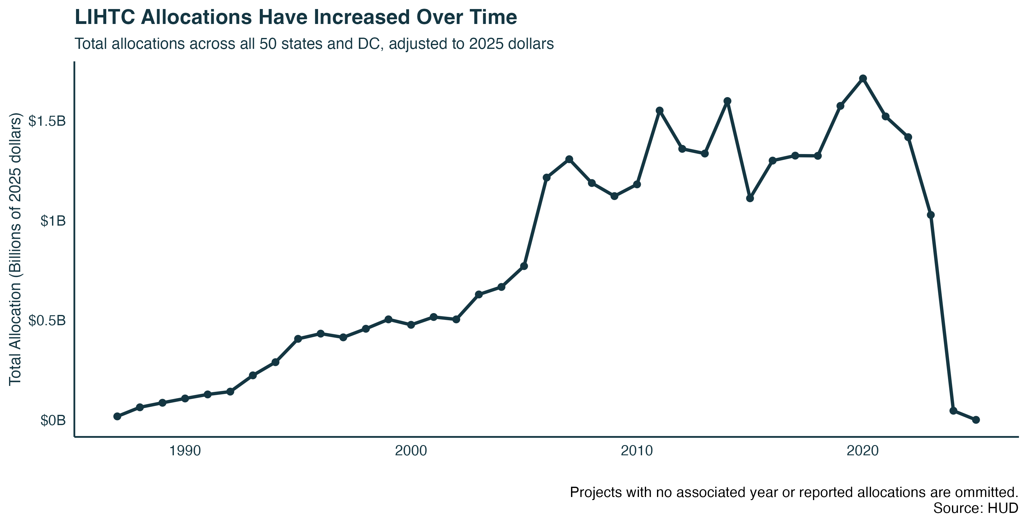
Allocations Over Time
Notes:
Link to state allocations: https://rlwagner.shinyapps.io/state_allocations_app/

Slide 11
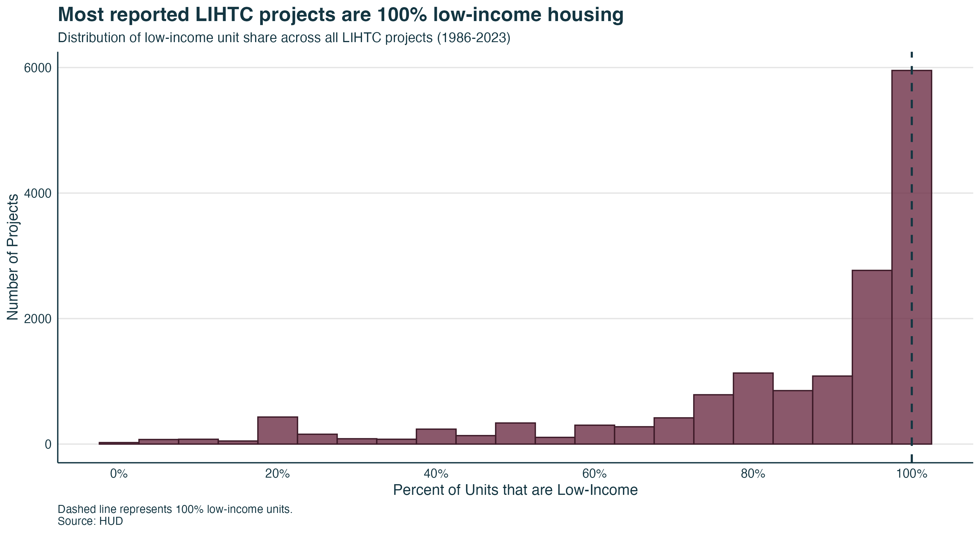
Low-Income Units

Slide 12
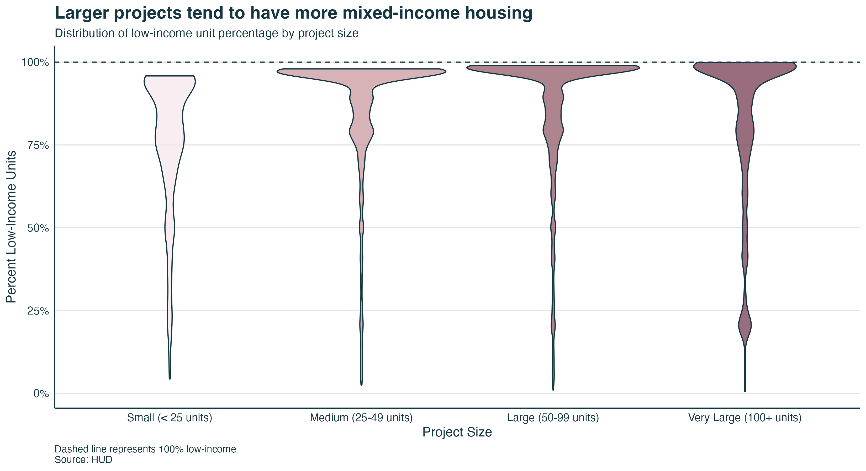
Low-Income Units

Slide 13
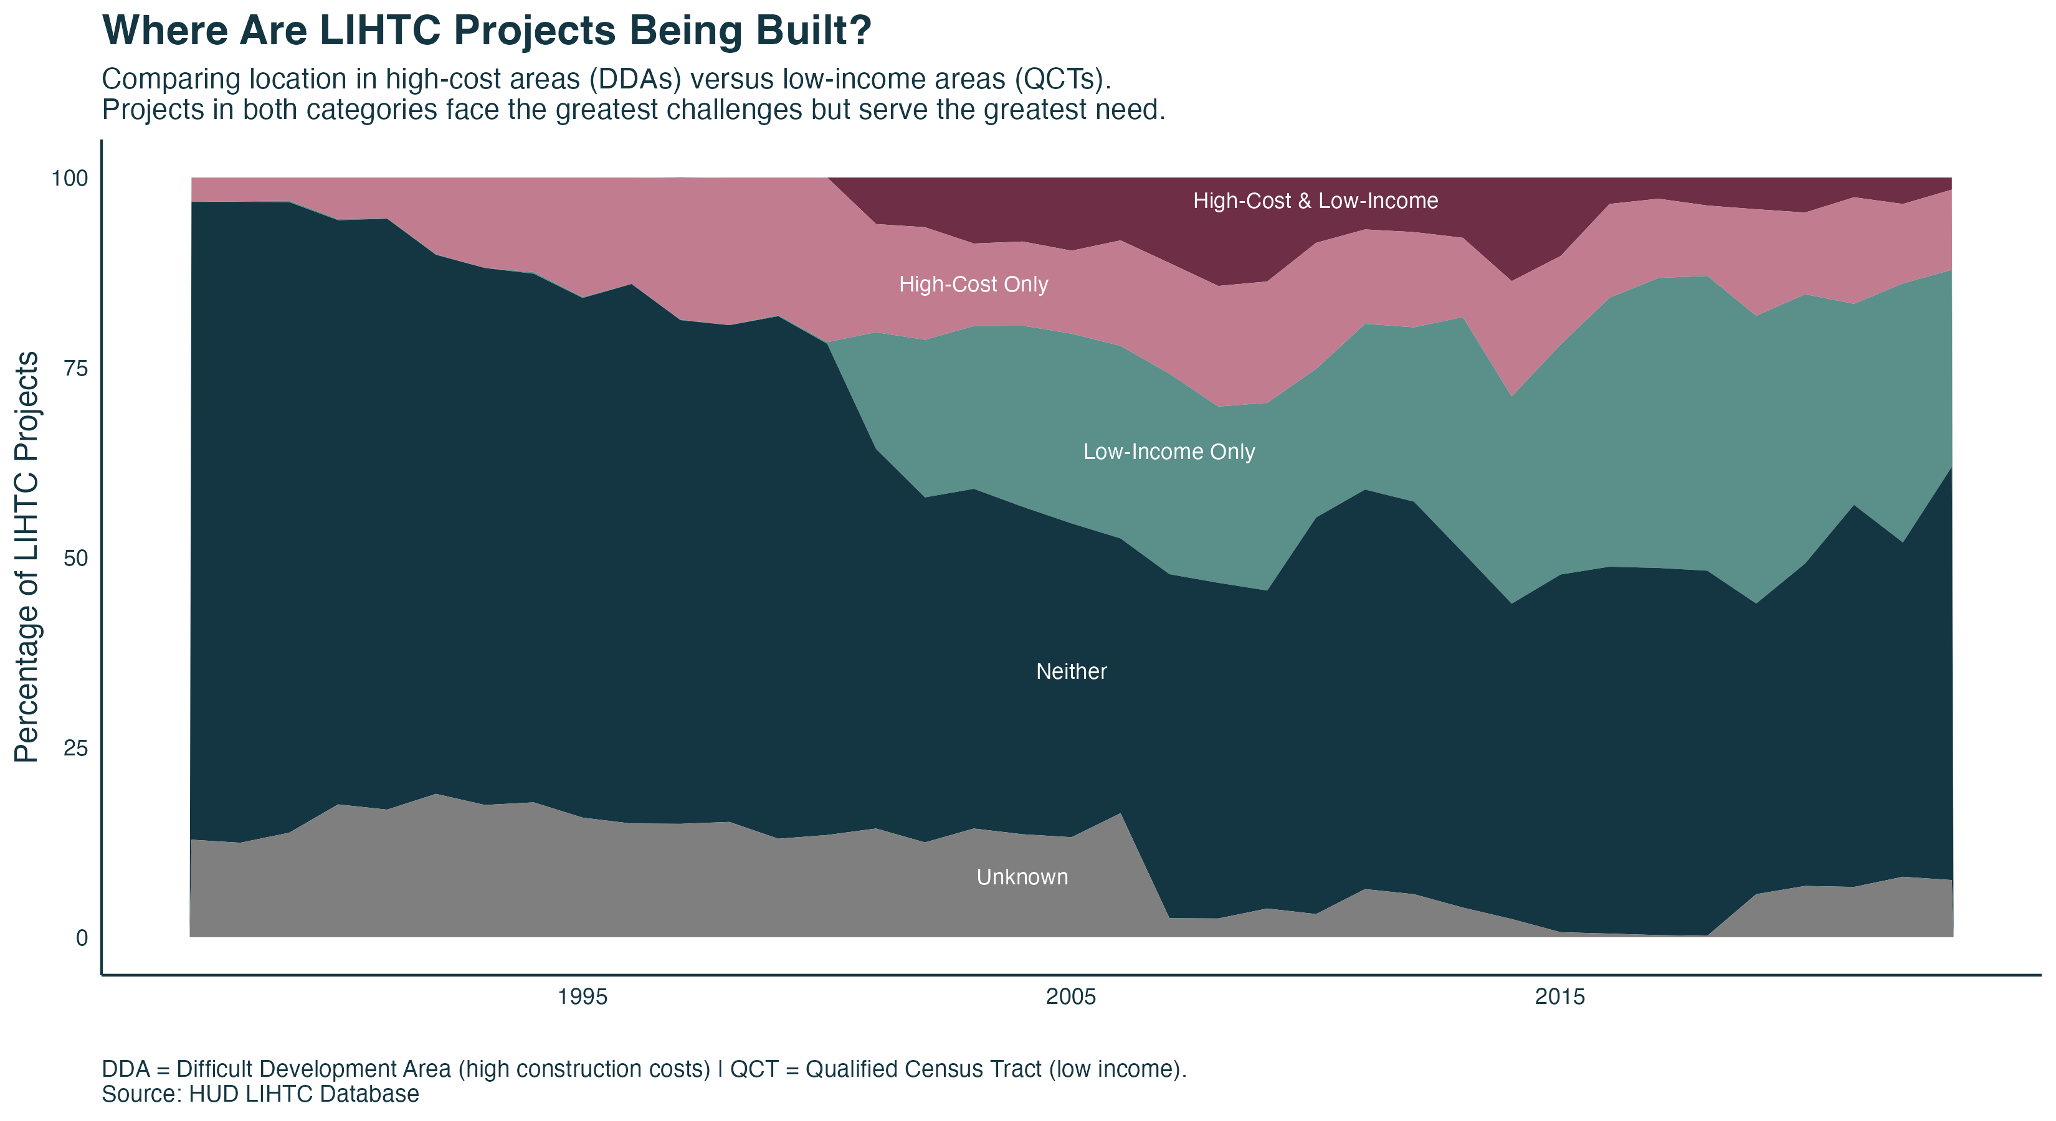
DDAs and QCTs

Slide 14
Takeaways & Next Steps
A need for better data collection processes
Policies to strengthen LIHTC against market failures
Support for LIHTC development in rural communities
Emphasis on mixed-income development
Increased development in high-cost and low-income tracts
LITCH is a powerful, bipartisan driver of affordable housing development—lets keep it that way.
Questions?

